Slide 1
Clustering
V. Lyubchich

Slide 2
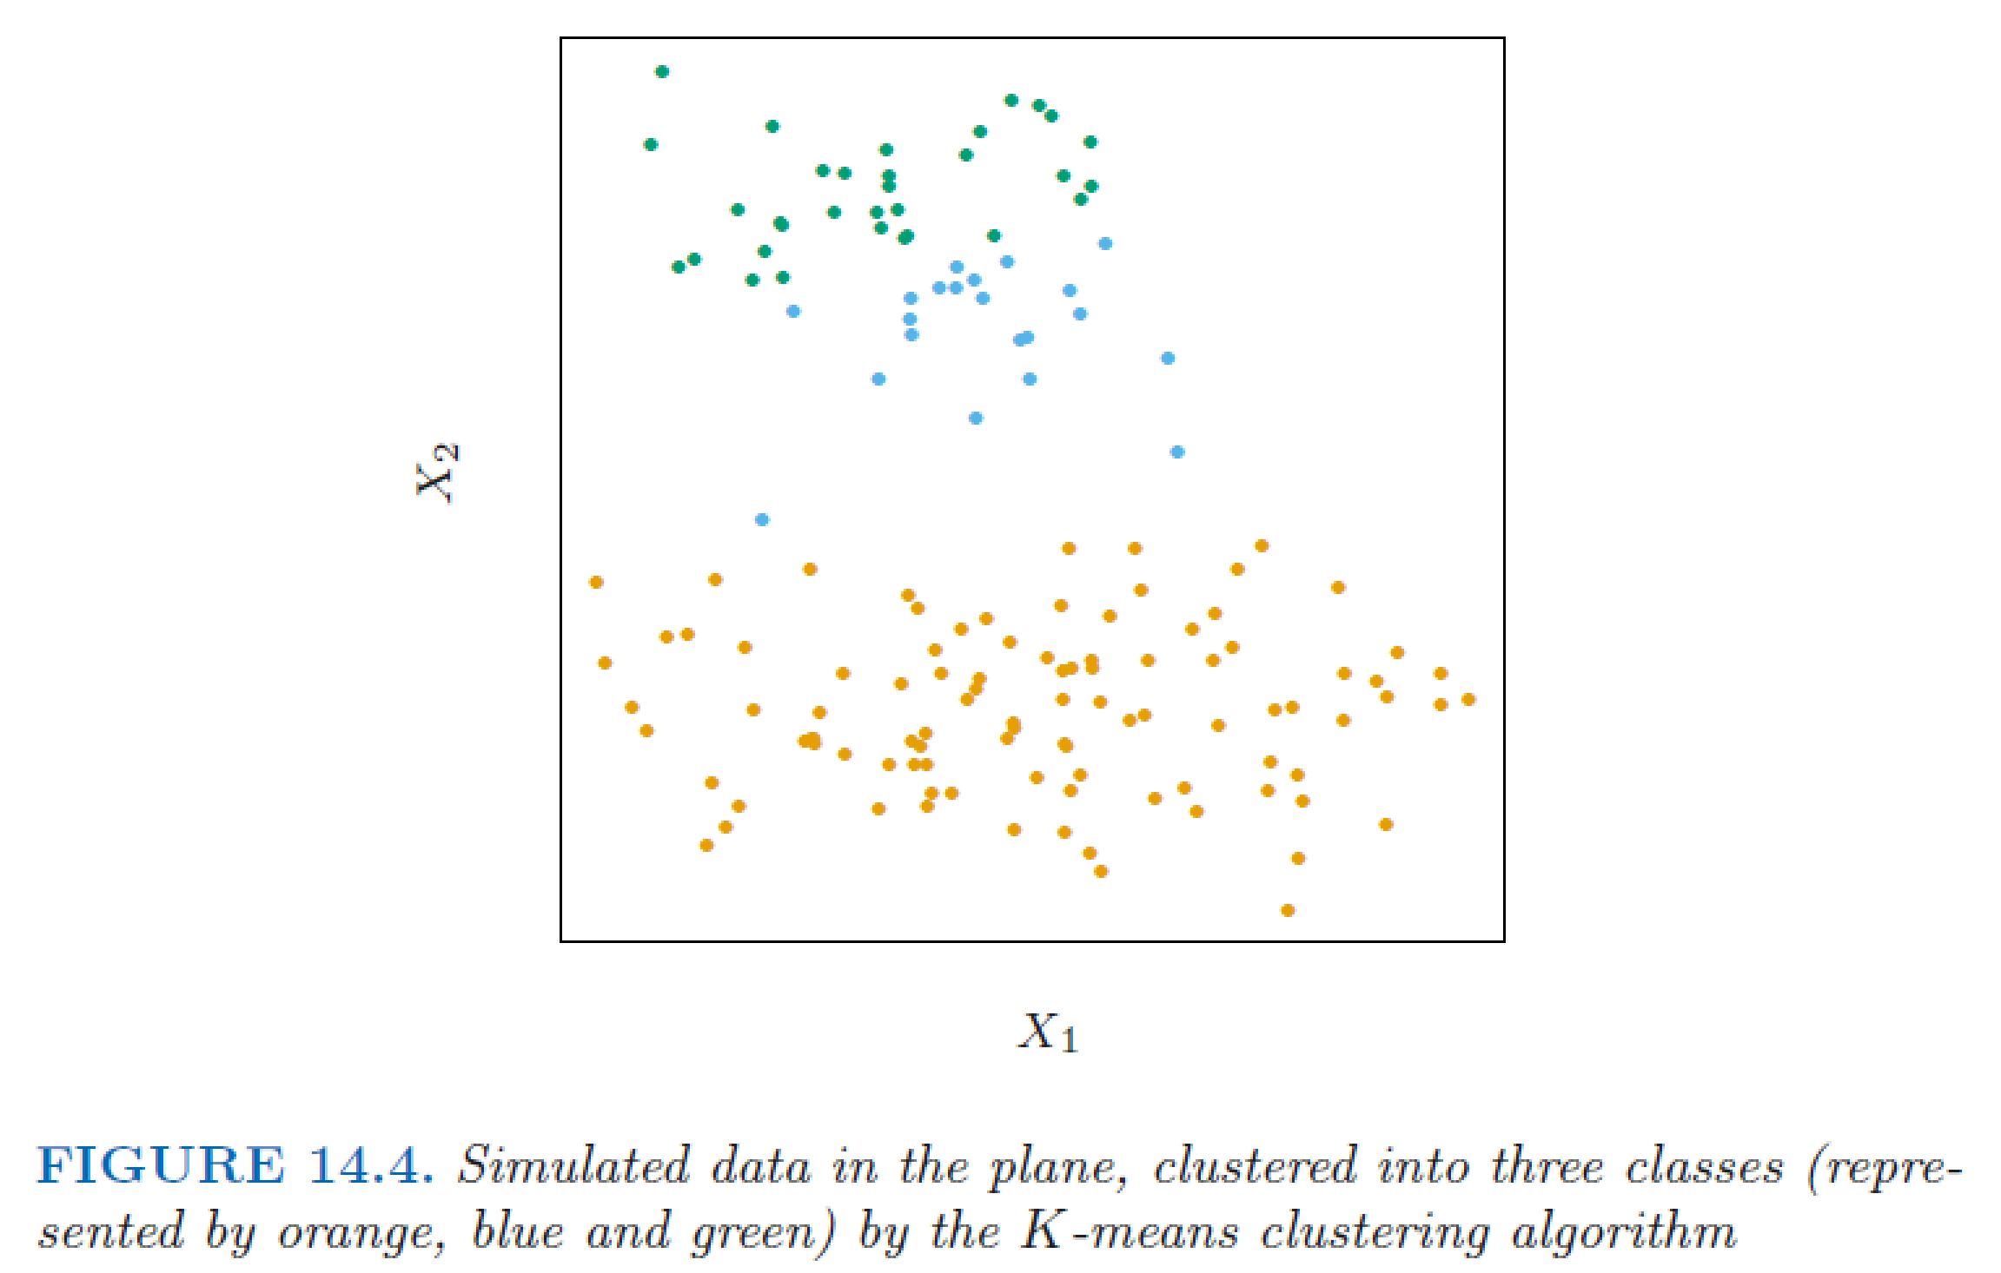
Major points
- Cluster is a subset of observations that are most similar compared to other observations
Degree of similarity (or dissimilarity, a.k.a. distance)
Method to calculate
distance between
clusters
Hastie et al. (2009)

Slide 3
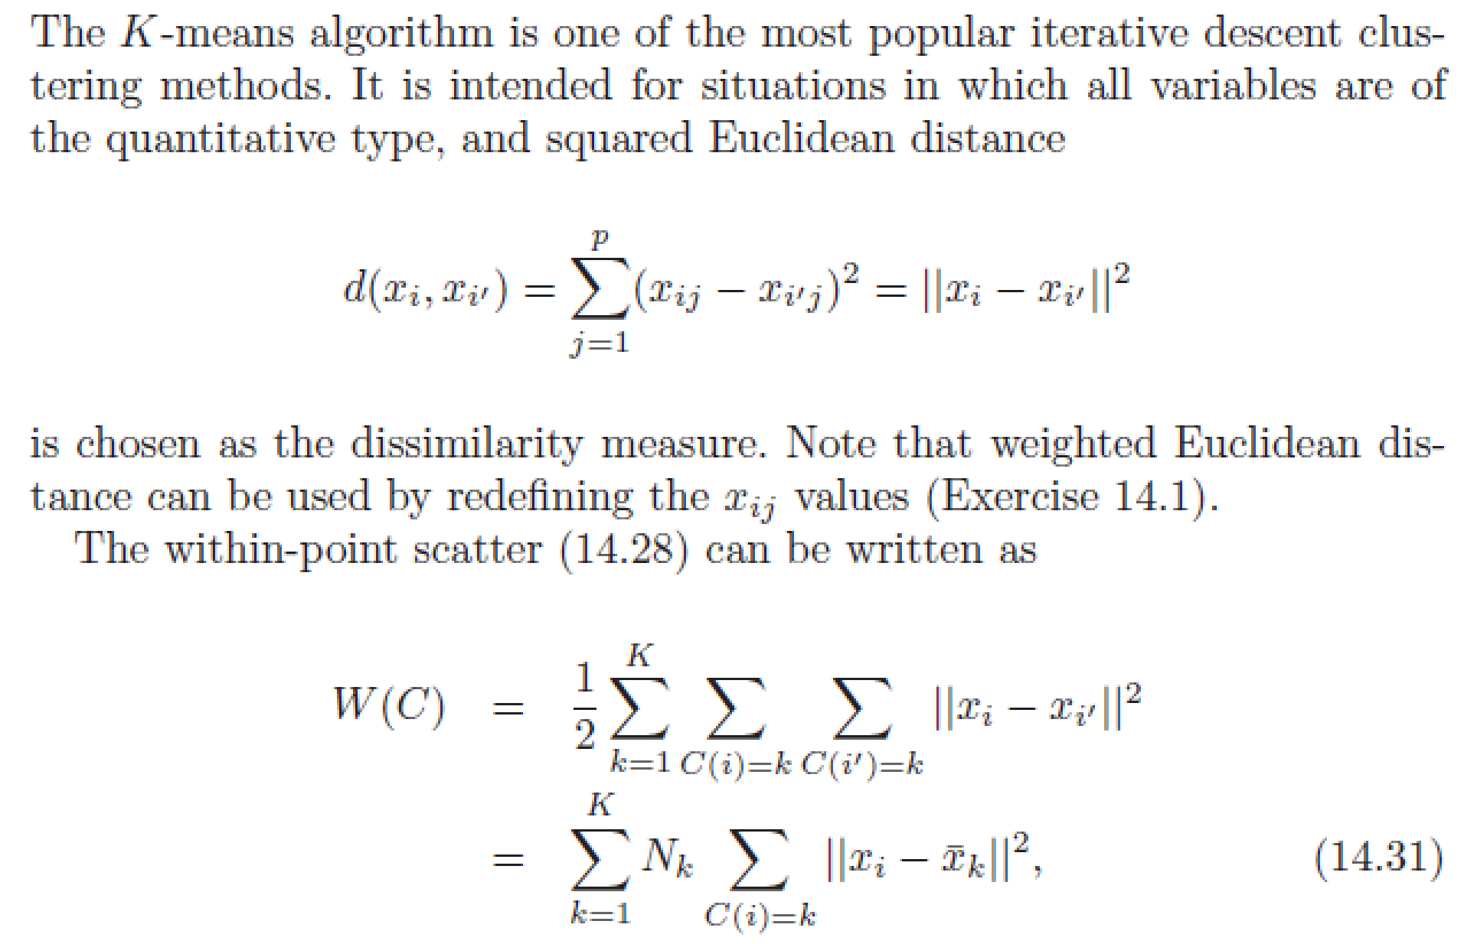
K-means example (also K-medoids)
Hastie et al. (2009)

Slide 4
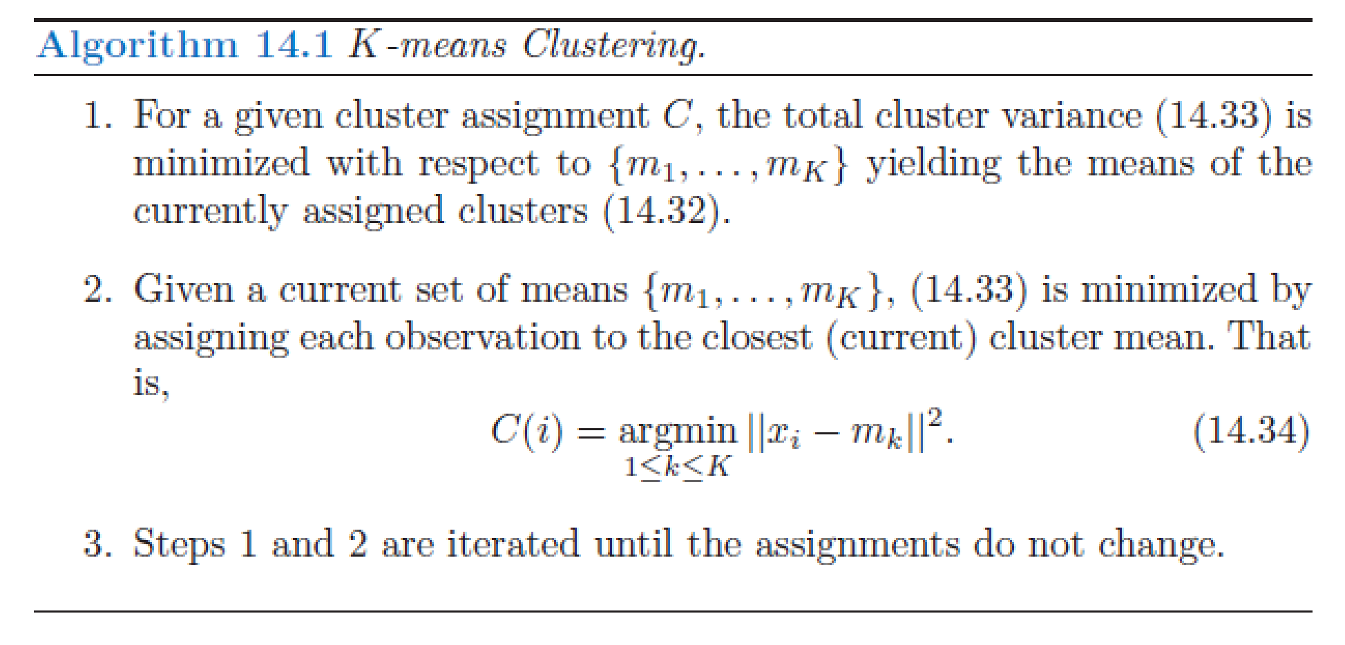
K-means algorithm
Hastie et al. (2009)

Slide 5
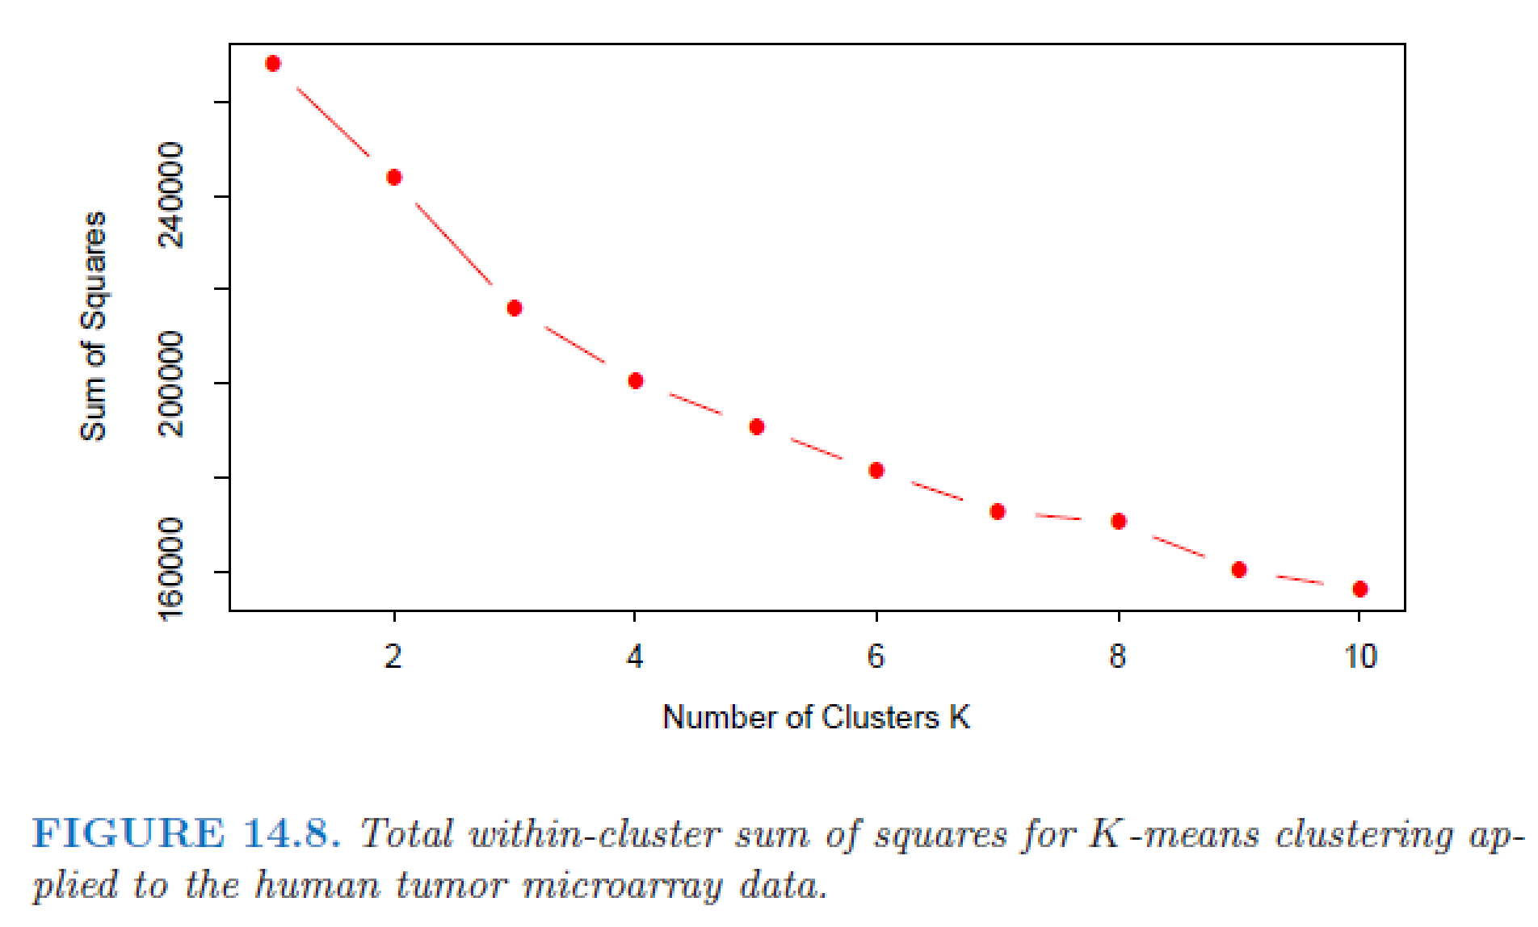
Number of clusters can be identified from the data
Hastie et al. (2009)

Slide 6
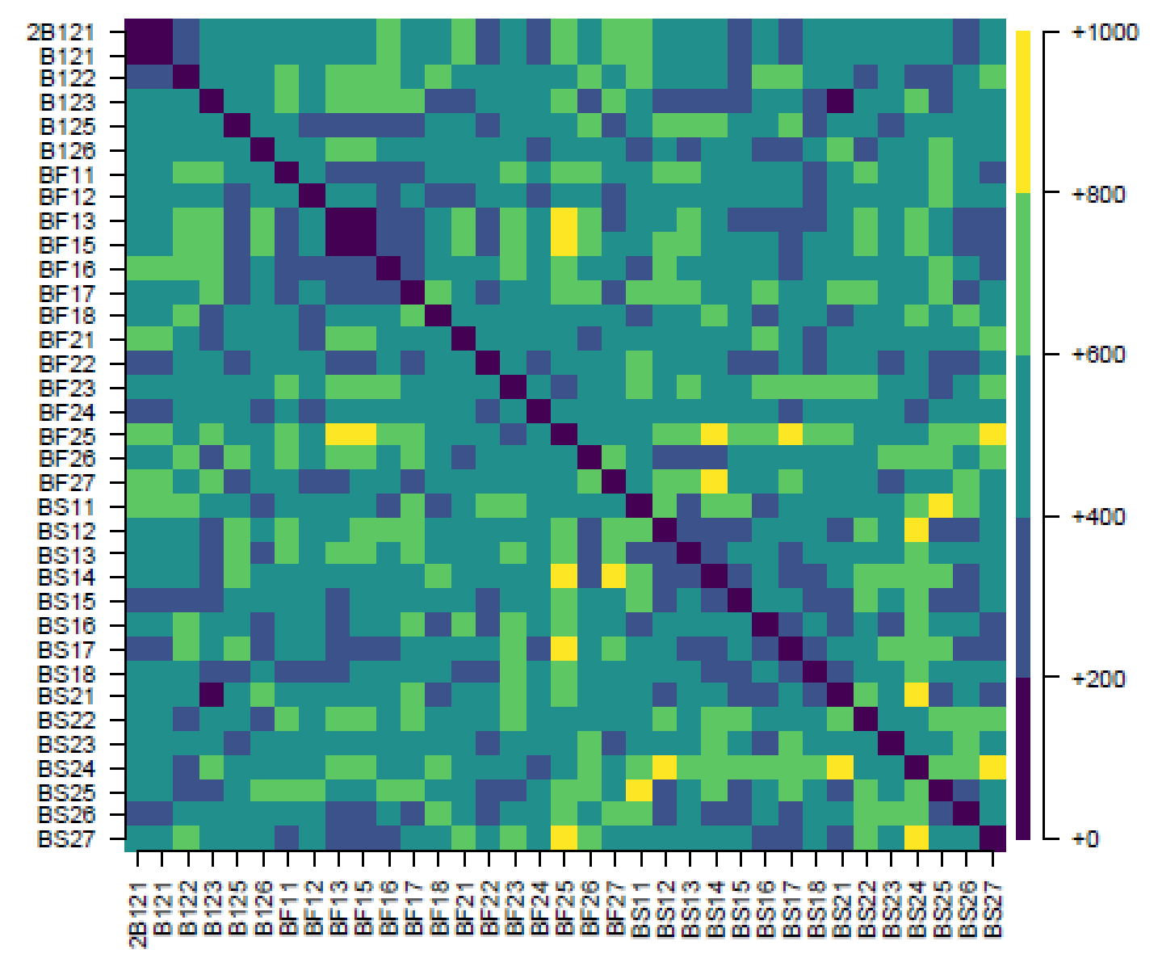
Distance matrix of fish based on similarities of Sr:Ca in their otoliths

Slide 7
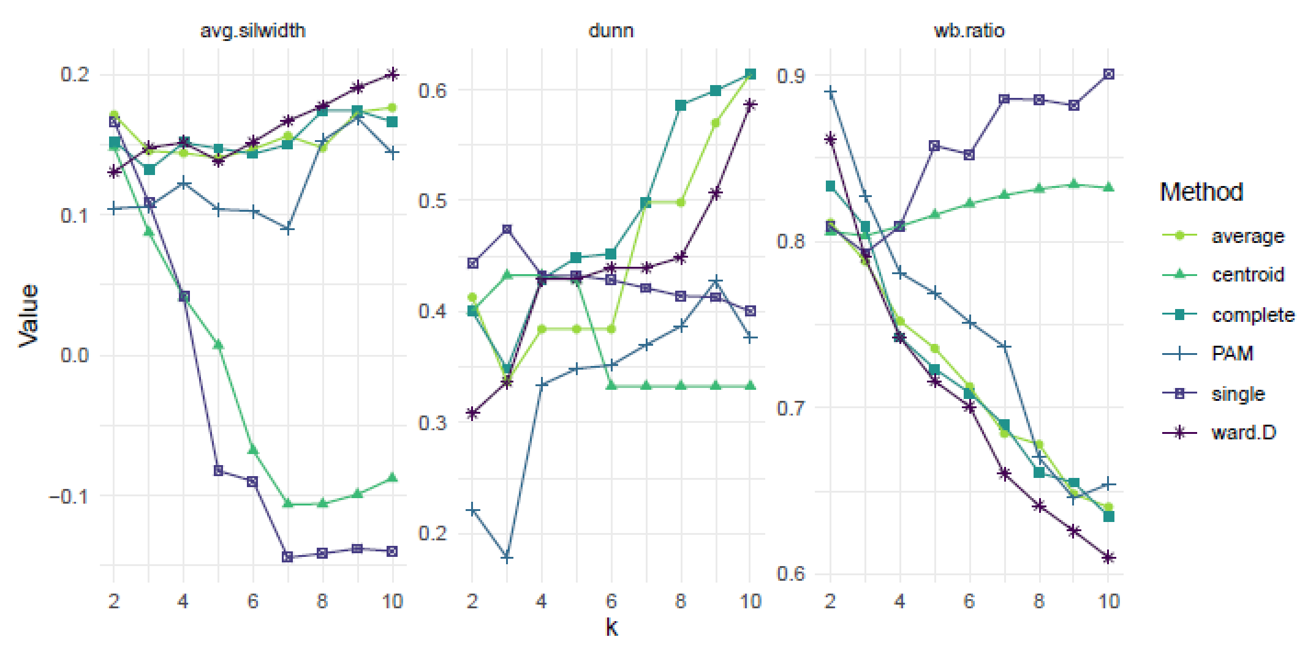
Internal cluster validity indices for different number of clusters (k) and method of hierarchical clustering or PAM (Method)
Larger is better
Larger is better
Smaller is better

Slide 8
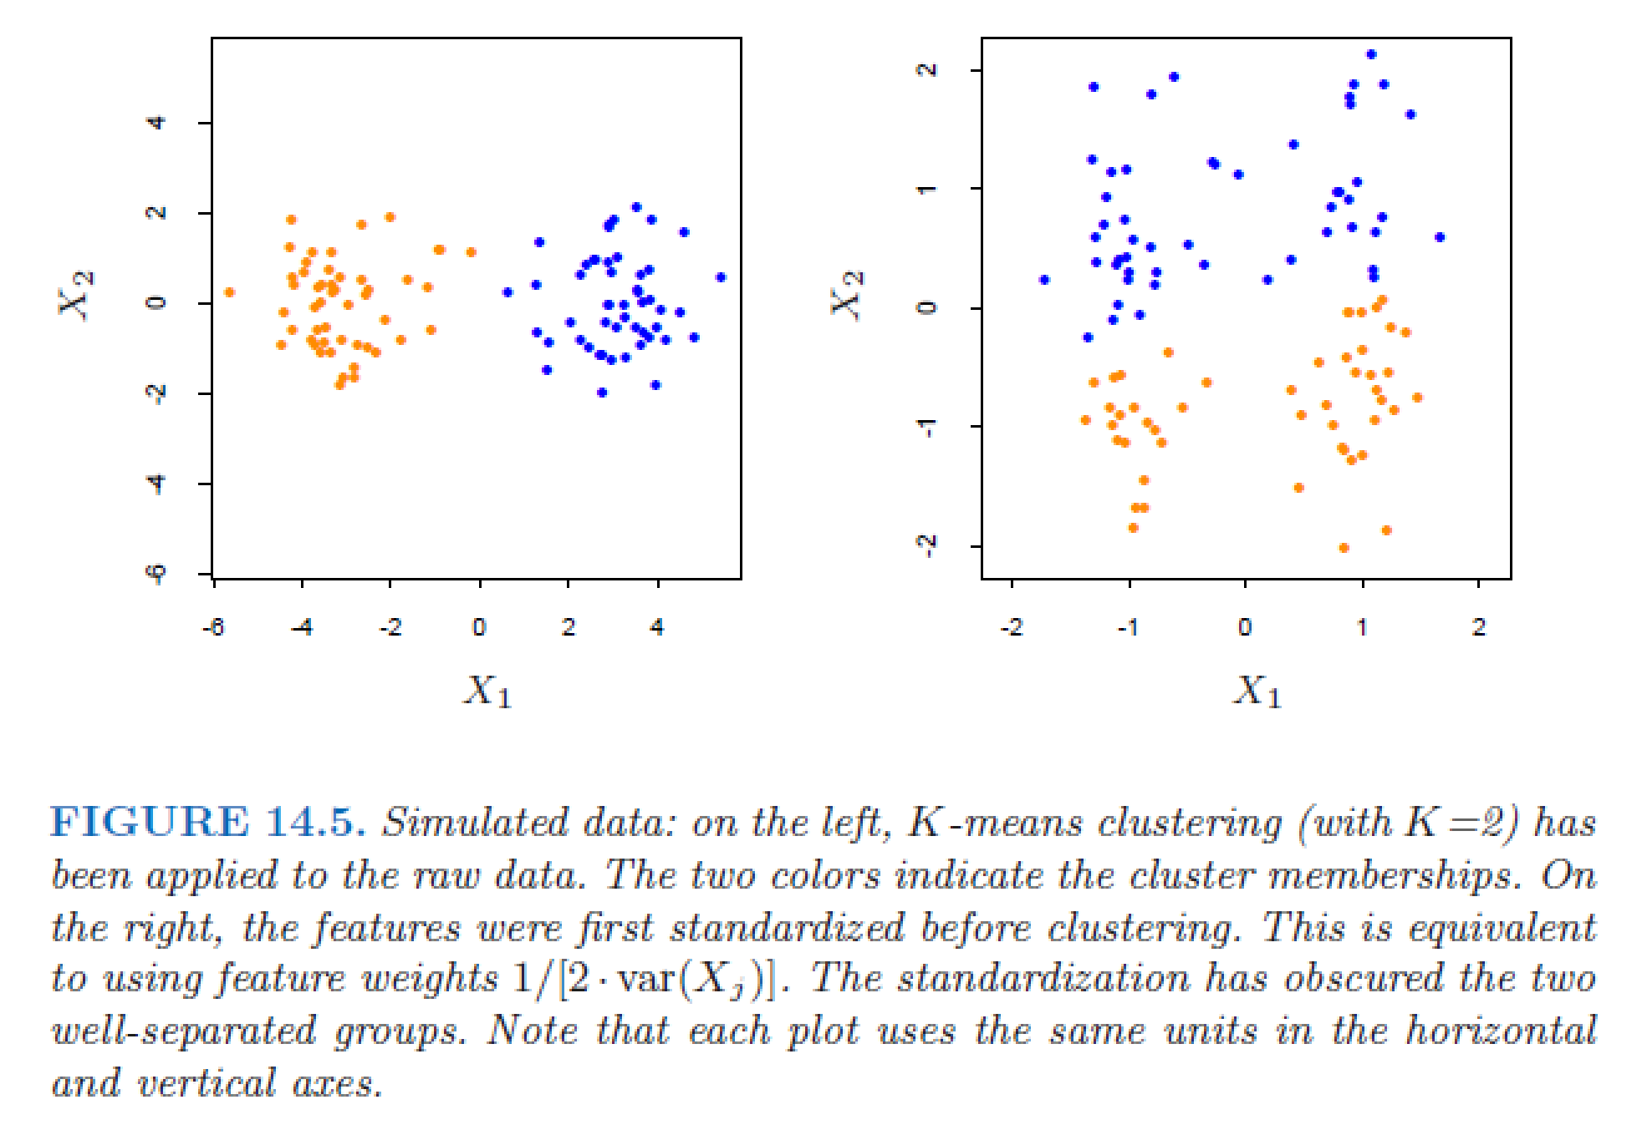
Standardization of data may affect separability of clusters
Hastie et al. (2009)

Slide 9
Specific methods for time series
See Maharaj et al. (2019) for references. General groups of methods are:
observation-based
feature-based
model-based

Slide 10
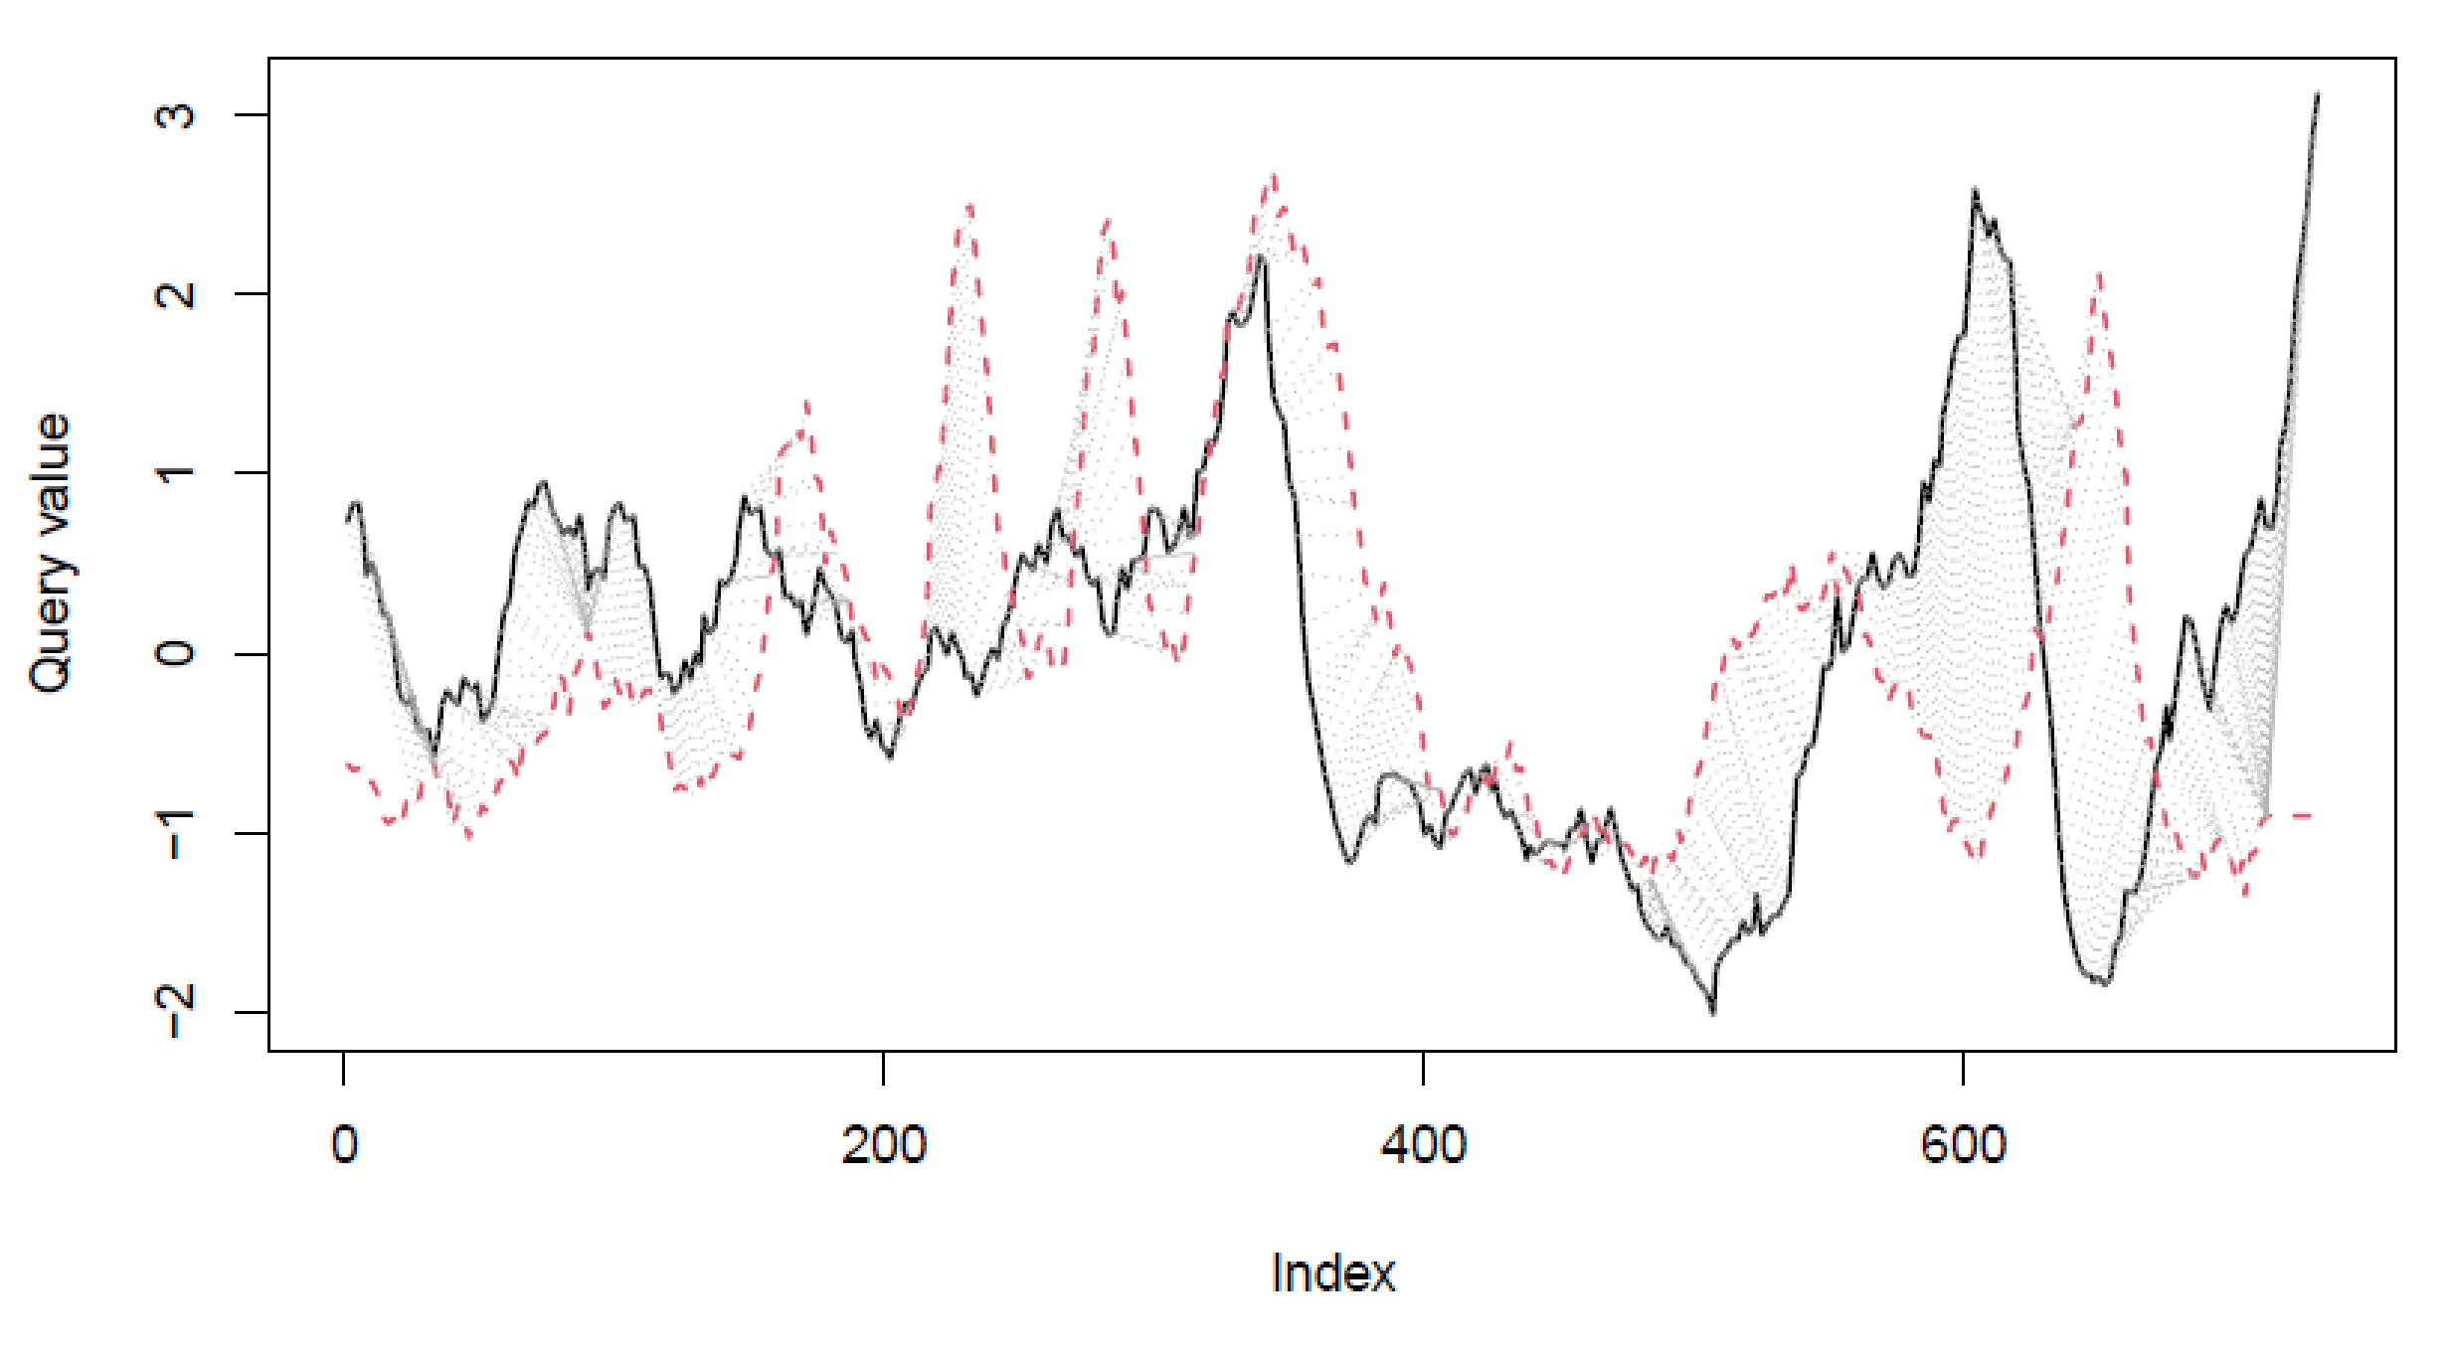
Dynamic time warping (DTW) of two time series
Observation-based clustering method
DTW distances are, essentially, Euclidean distances but calculated along the DTW alignments (the dotted lines)

Slide 11
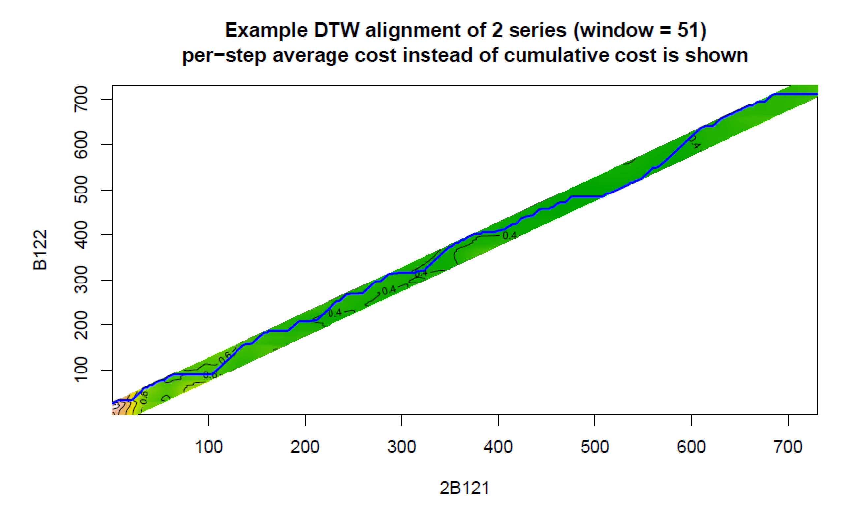
Another look at the DTW alignment

Slide 12
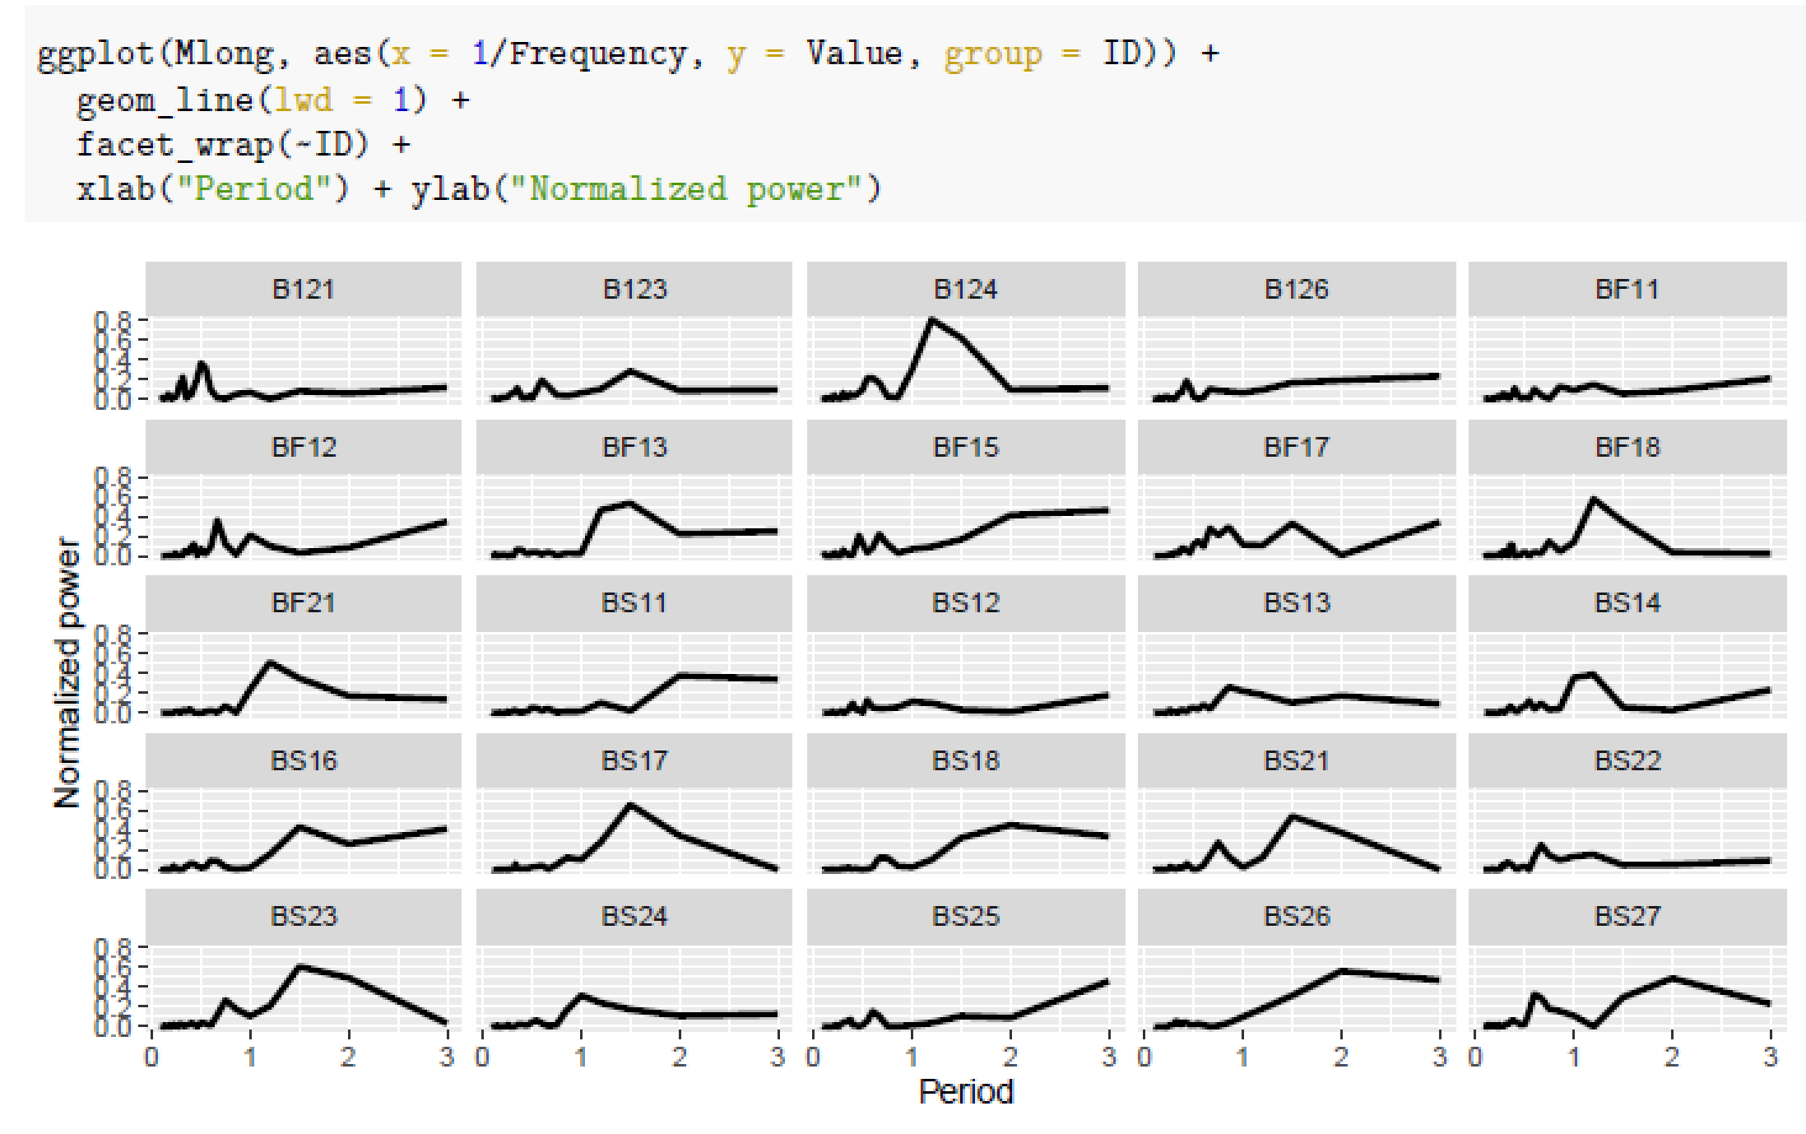
Cluster series of estimated periodograms or autocorrelations
Feature-based clustering method
Note: for unequally-spaced time series, can use Lomb—Scargle periodograms (see package lomb)

Slide 13
Cluster time series based on trend coefficients (trend synchronization)
Model-based clustering method
https://cran.r-project.org/web/packages/funtimes/vignettes/tsclusters.html

